Slide 1
Question 35.7.5
Parallel light rays cross interfaces from medium 1 into medium 2 and then into medium 3. What can we say about the relative sizes of the index of refraction of these media?
n₁ > n₂ > n₃
n₃ > n₂ > n₁
n₂ > n₃ > n₁
n₁ > n₃ > n₂
none of the above
1
2
3

Slide 3
Lens
Image
Light Source

Slide 4
Fish out of water
Rays from fish head
Eyes
d
Rays from fish tail

Slide 5
Fish out of water
Rays from fish
Eyes
d
Rays from fish
Fish in water
Image of Fish
Rays appear to come from here
d’

Slide 6
s
s’
Rays from fish
Fish in water
ℓ
Image of Fish
θ₂
θ₁
ℓ
θ₁
θ₂
Rays appear to come from here
n₁ (Large)
n₂ (Small)

Slide 7
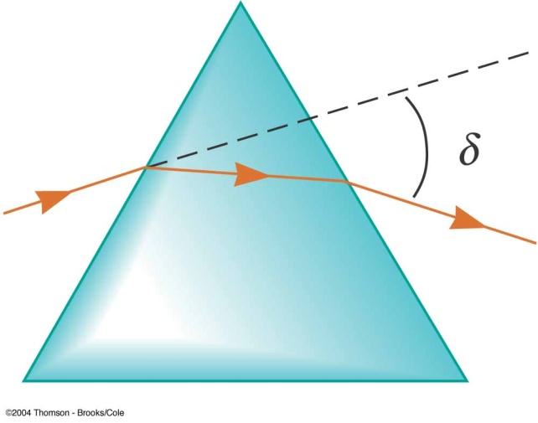
Question 223.15.1
Consider the prism to your right. If we illuminate it with white light, which color will be at the top of the rainbow?
Red
Yellow
Green
Blue
Violet

Slide 8
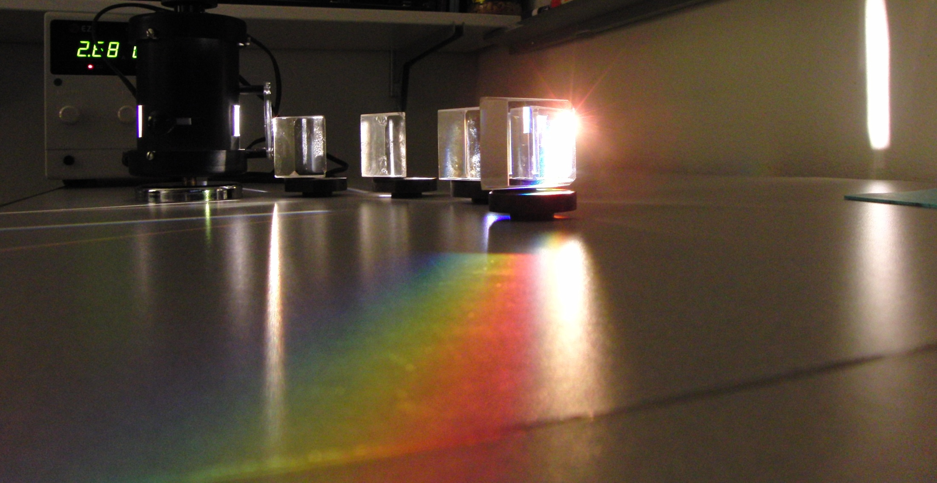

Slide 9
δ_{R}
White Light
δ_{B}
Red
Blue

Slide 10
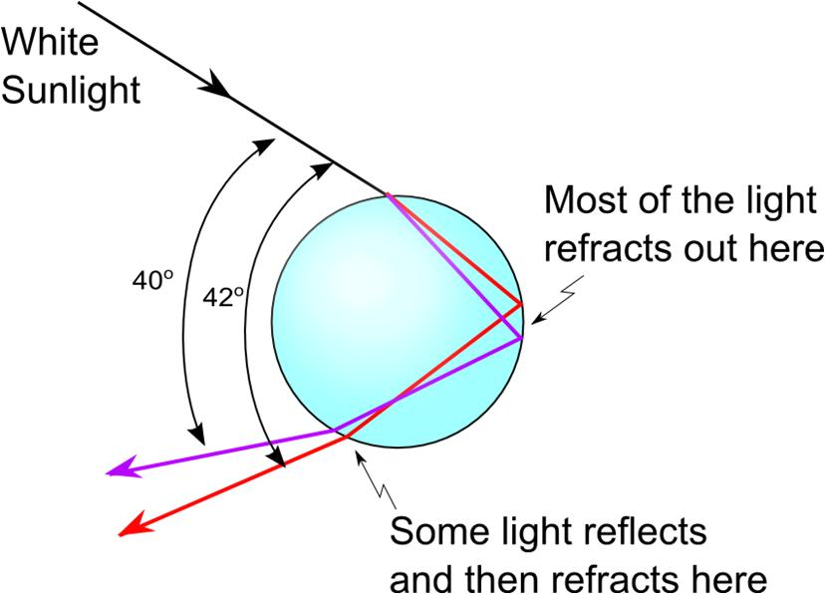

Slide 11
Finding δ
Φ/2
δ
η
φ
φ
φ
β
θ₂
α
α
θ₁
θ₂
θ₂
n

Slide 12
Question 223.15.2
You build a prism out of a thin walled container filled with water. If the water prism is immersed in a tank of water, does it still make a rainbow?
Yes
No
Can’t tell

Slide 13
Question 223.15.3
You are building a camera with refractive lenses. Would you expect all colors of light to focus at the same point?
Yes
No
Can’t tell

Slide 14
